Slide 1
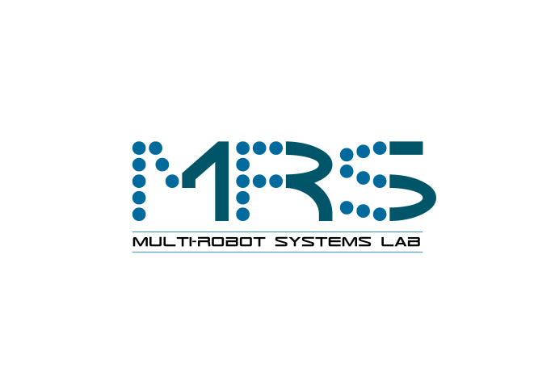

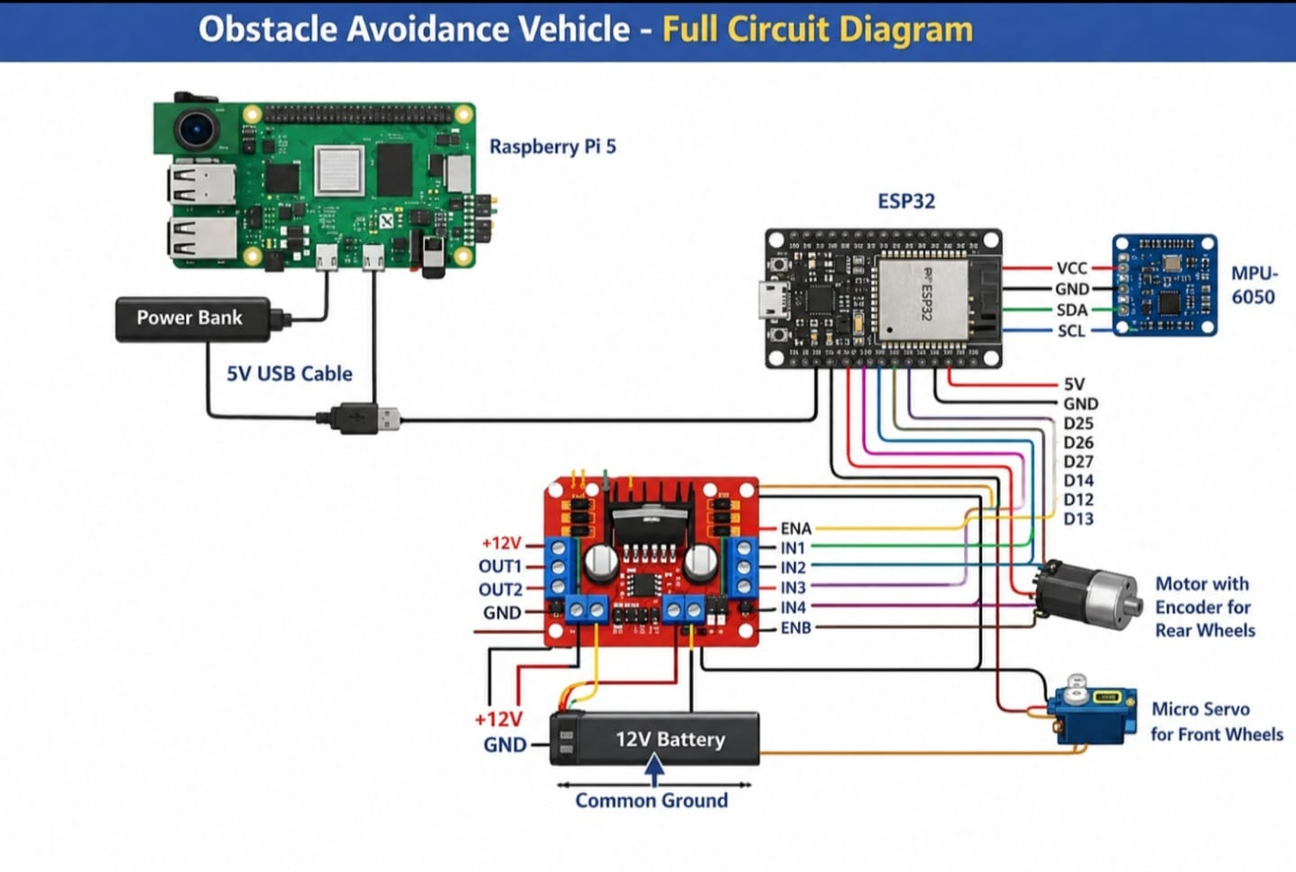
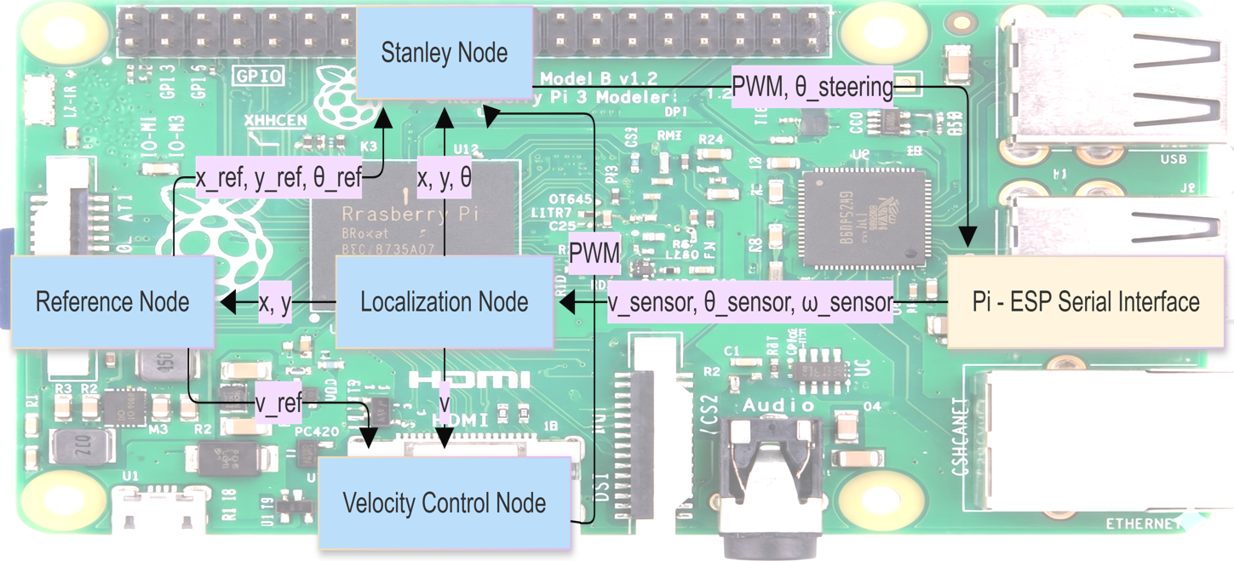
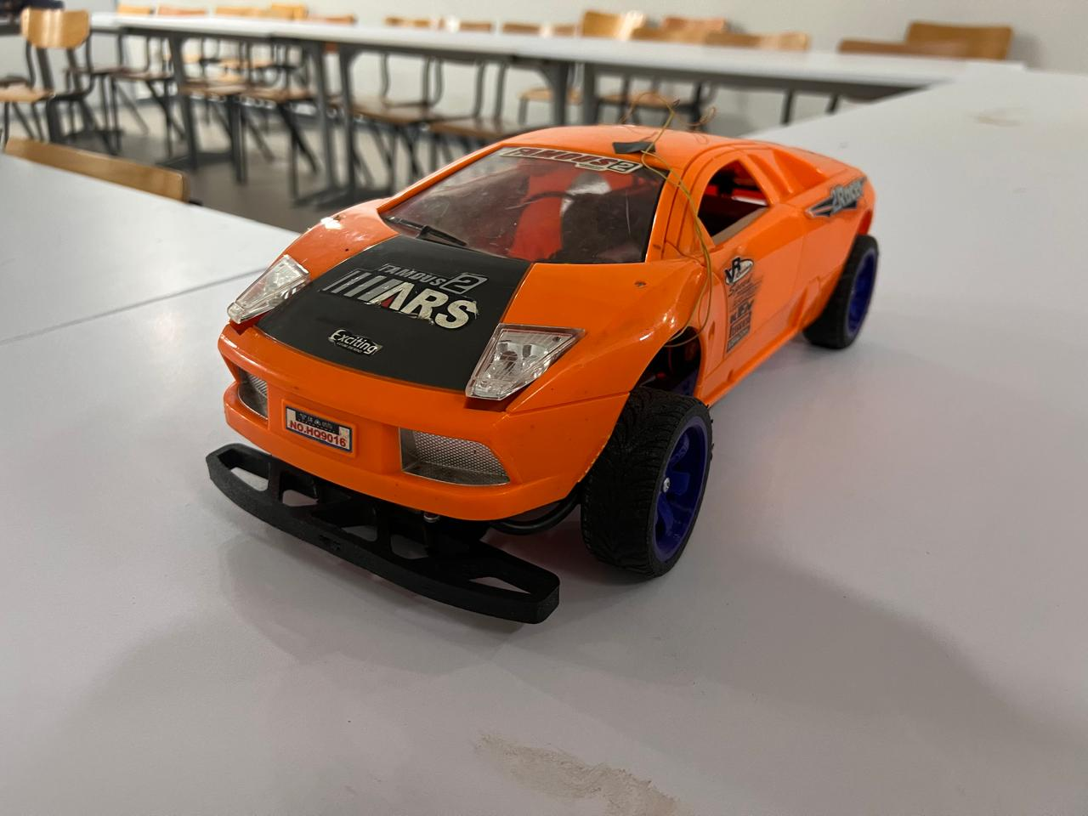
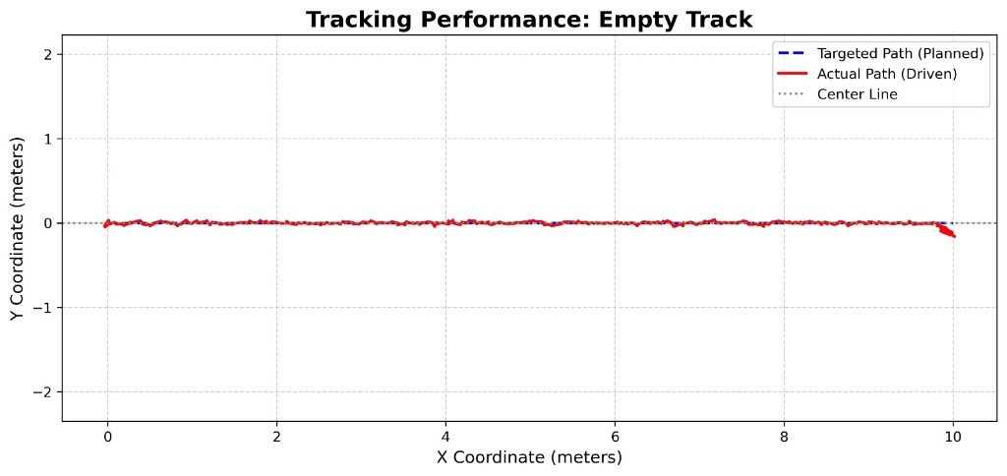

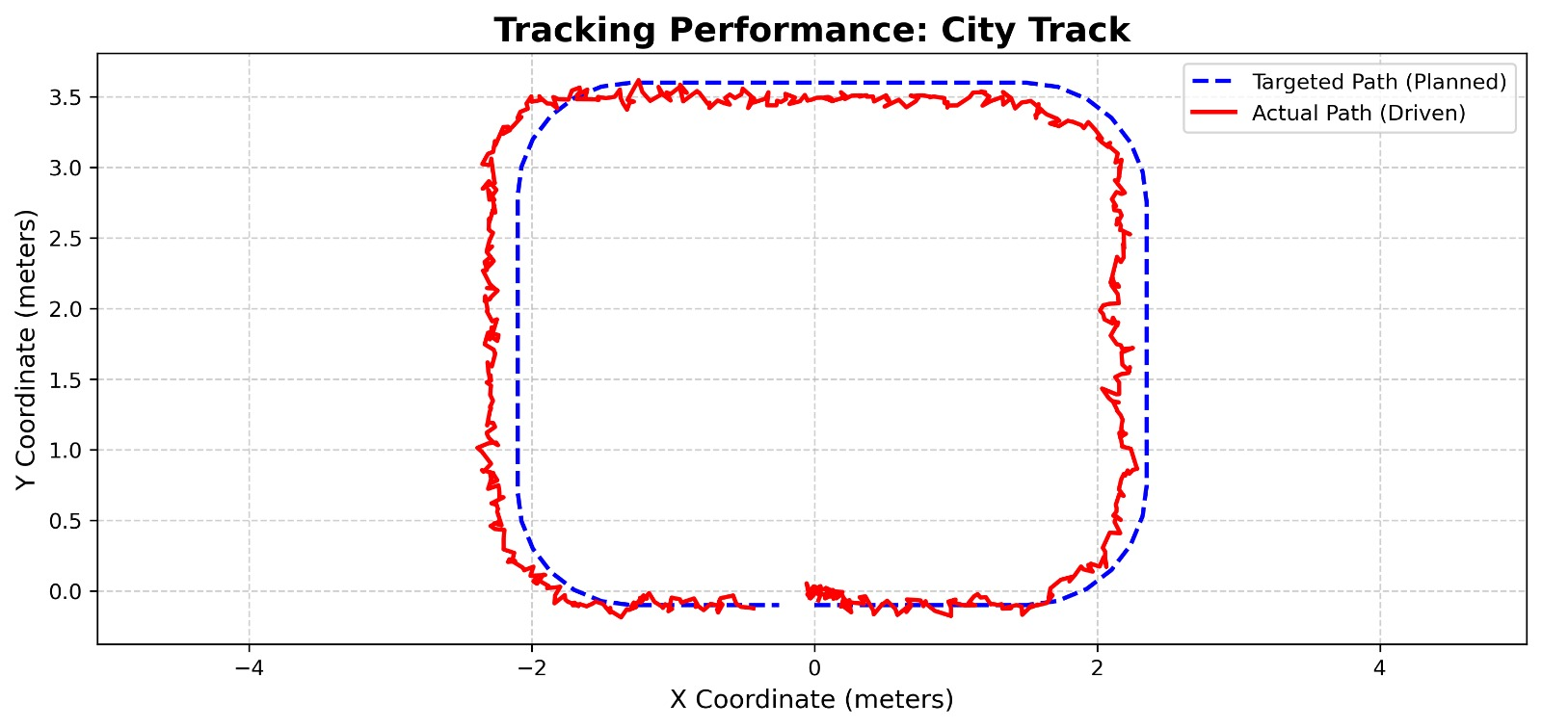
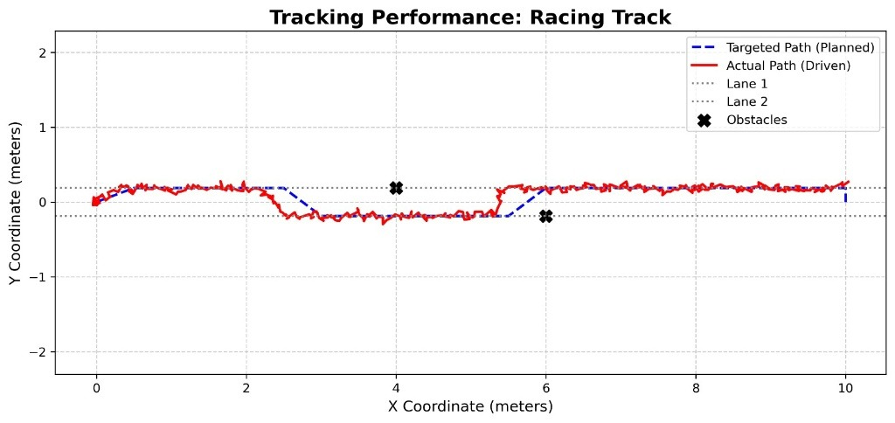

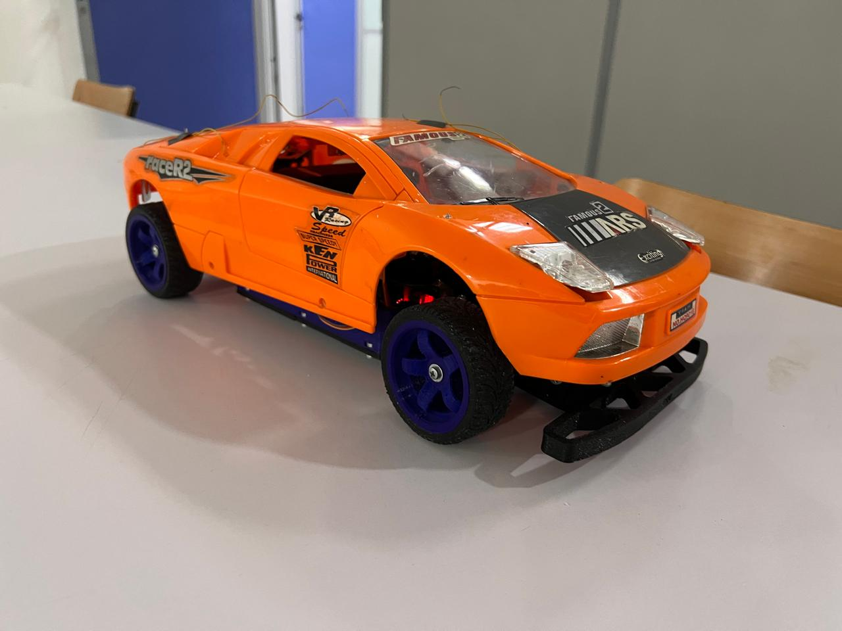
Autonomous Systems
OBSTACLE AVOIDANCE FOR AN UNMANNED GROUND VEHICLE
Omar Mones Amr Sayed Zakaria Eleila Nooreldin Sameh Mohammed Hany Asser Mohamed
omar.hendawy amr.behery zakaria.eleila Nooreldin.ahmed mohammed.hany asser.abdallah
German University in Cairo (GUC), Egypt
ABSTRACT
METHODS
PATH TRACKING RESULTS
This paper presents the design and implementation of an autonomous unmanned ground vehicle (UGV) capable of path tracking and obstacle avoidance using offline-generated reference trajectories. The system integrates a Raspberry Pi 5, ESP32, IMU sensor, encoder, and motor hardware within a ROS2-based architecture. Vehicle localization is achieved using an Extended Kalman Filter (EKF), while velocity and lateral motion are controlled using a P controller and a Stanley controller respectively. The vehicle was tested on three different tracks in simulation and real-world experiments. Results showed that the EKF improved tracking accuracy and reduced path-following error compared to operation without filtering.
The system uses two micro-controllers: a Raspberry Pi 5 hosting the ROS2 stack and an ESP32 handling low-level I/O. The ESP32 reads the heading angle from the IMU 6050 and the wheel speed from the encoder, then forwards them to the Pi over serial. The Pi runs five ROS2 nodes: a Serial Interface node for ESP32 communication, a Reference node that loads desired waypoints from a CSV and publishes target X, Y, heading and velocity, a Localization node that runs an Extended Kalman Filter (EKF) with states [x, y, theta] to fuse the motion model with IMU measurements, a Velocity Controller node that applies a P controller and converts the command to a PWM signal, and a Lateral Controller node that uses a Stanley controller to compute the steering angle from heading and cross-track errors. The ESP32 then drives the DC gear motor through an L298N H-bridge and steers the micro-servo. Desired velocity is shaped by path curvature so the vehicle slows down on sharp turns.
Empty Track (Straight Lane): In this map, the vehicle moves along a single straight lane of 10 m. The actual path closely follows the planned center line in both configurations. Without the Kalman filter, the standard deviation was 2.71 cm, and with the Extended Kalman Filter (EKF) it dropped to 2.31 cm, showing a small but consistent improvement on this simple track.
Racing Track (Obstacle Avoidance): The second map features a two-lane obstacle-avoidance track where the vehicle must maneuver around two distinct obstacles. The vehicle successfully executed lane changes to avoid both obstacles. On this track, the EKF significantly reduced the path-following standard deviation from 15.11 cm to 9.61 cm. This represents a 36% improvement in tracking accuracy during more dynamic lateral movements.
OBJECTIVES
Design and implement a fully autonomous UGV capable of tracking a desired path given a set of offline-generated reference points.
Develop a robust state estimation module using an Extended Kalman Filter (EKF) to fuse IMU and encoder data for accurate localization.
Implement a P controller for velocity regulation and a Stanley controller for lateral path tracking on a modular ROS2-based architecture.
Validate the system in simulation and real-world testing across straight, two-lane obstacle, and city tracks to verify path-following performance.
RESULTS
The vehicle was evaluated on three tracks: a 10 m straight lane, a two-lane obstacle-avoidance track with obstacles at 4 m and 8 m, and a closed city-style track with sharp turns. On the straight track, the path-following standard deviation dropped from 2.71 cm without the Kalman filter to 2.31 cm with the EKF. On the two-lane obstacle-avoidance track, the EKF reduced the standard deviation from 15.11 cm to 9.61 cm, a 36% improvement, while still successfully avoiding both obstacles. On the more demanding city track, the standard deviation went from 146.18 cm to 145.83 cm, indicating that the EKF still helps marginally but sharp turns dominate the remaining error. Overall, the EKF consistently improved tracking accuracy, with the largest gains on tracks of moderate complexity.
CONCLUSIONS
REFERENCES
The project successfully demonstrated an autonomous unmanned ground vehicle capable of path tracking and obstacle avoidance using a modular ROS2 architecture. An Extended Kalman Filter combined with a P controller for speed and a Stanley controller for steering allowed reliable navigation across three test tracks. The EKF consistently reduced localization error, with obstacles successfully avoided on the two-lane scenario, showing that low-cost hardware is sufficient for a working autonomous navigation pipeline.
[1]J. E. Naranjo, F. Serradilla, and F. Nashashibi, "Speed control optimization for autonomous vehicles with metaheuristics," Electronics, vol. 9, no. 4, p. 551, 2020.
[2]Z. He, L. Nie, Z. Yin, and S. Huang, "A two-layer controller for lateral path tracking control of autonomous vehicles," Sensors, vol. 20, no. 13, p. 3689, 2020.
[3]Y. Wang, D. Liu, and E. Matson, "Accurate perception for autonomous driving: Application of Kalman filter for sensor fusion," IEEE SAS, 2020.
[4]J. Feng et al., "Path planning and trajectory tracking for autonomous obstacle avoidance in AGVs at automated terminals," Axioms, vol. 13, no. 1, p. 27, 2024.
Scan to view our project!

